Slide 1
Tailoring Programs for Static Analysis via Program Transformation
ICSE’ 20
Rijnard van Tonder & Claire Le Goues
Carnegie Mellon University

Slide 2
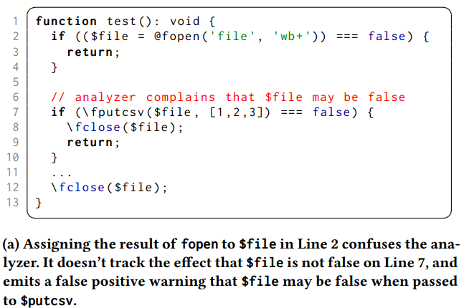
Motivation:
False positive (spurious warnings) in static analysis
For example:

Slide 3
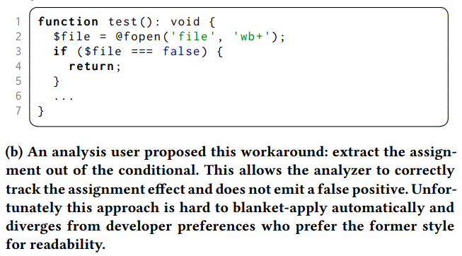
Insight:
An analysis user always has one notable ability to influence analysis behavior regardless of analyzer options and implementation: modifying their program.

Slide 4


General Solution:

Slide 5
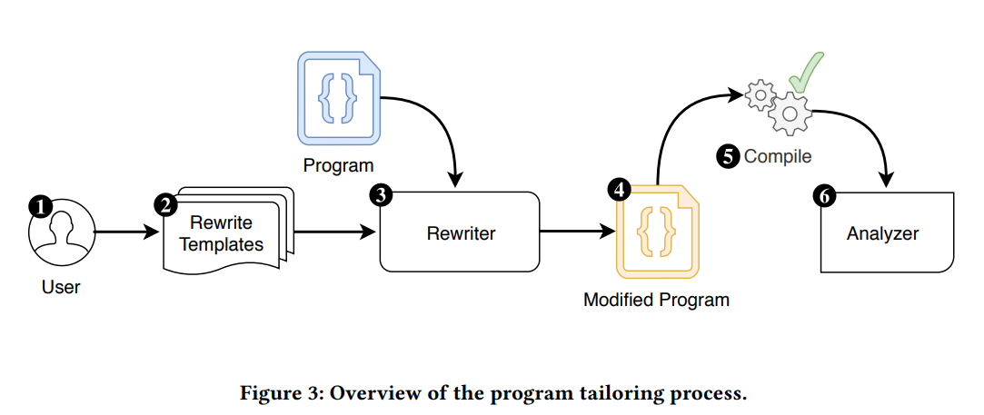
Approach:
Strength1: Every user can be a contributor

Slide 6
Approach:
Strength2: No source code modification (Based on comby)

Slide 7
Approach:
Strength3: No analyzer modification

Slide 8
Evaluation:
Static analyzer:
PHPStan for PHP
SpotBugs for Java
Clang Static Analyzer and CodeSonar for C
Infer for both Java and C
Dataset:
15 projects from Top100 popular projects for each language
Template(Pattern):
GitHub reports or comments containing the words “false positive”

Slide 9
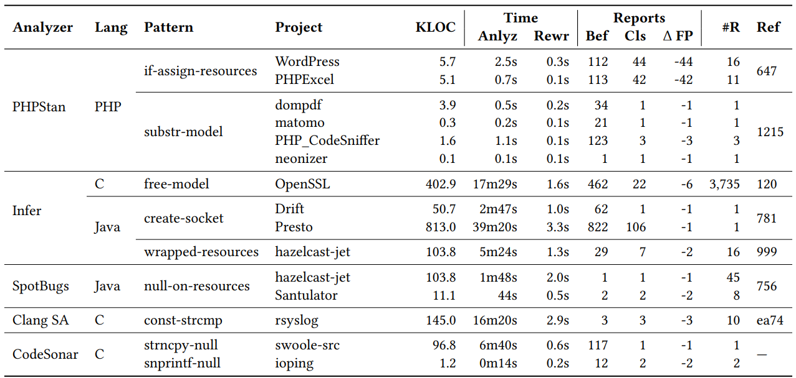
Evaluation:

Slide 10
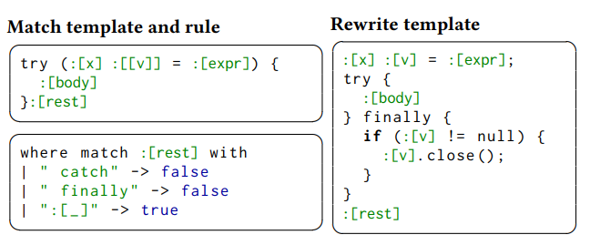
Discussion:
Developing patterns can take a few iterations to refine until they precisely match syntax of interest.
This approach is purely syntactic. Type information can be combined to check whether a method or object may cause a false positive.

Slide 11
Thanks

